Slide 1
END Semester Presentation ECON F266
Education and Labour market outcomes
of India - Study of Graduates
SUYASH MANGLA (2023A70593P)
ZORAWAR SINGH DHESI (2023A70524P)

Slide 2
OVERVIEW
This report covers the recent trends of unemployment in india and the major factors contributing to it.
In this report we have also done detailed analysis on graduates of India using Unemployment Rate, Labour Force Participation Rate , Work force Participation rate.
For analysis we have used data of years 2004-5, 2011-12, 2017-18 & 2023-24.
We have also displayed the distribution of graduates and the different sectors they are employed in.
The main industries that hire graduates are Agriculture, Trade and Hotel, Manufacturing, Finance, Public Administration ,Transport & other services.

Slide 3
Summarizing the Previous Work
Unemployment in India is a detrimental effect on the labor market and its outcomes, leading to decreased productivity, lower wages, and increased inequality.
Main causes of graduate unemployment includes The rapid expansion of higher education without corresponding growth in employment opportunities & Skill mismatch due to outdated curriculums.
Unemployment leads to reduction in aggregate demand & Downward pressure on wages.
Addressing this issue requires a tailored approach considering each state's unique economic and social context.

Slide 4
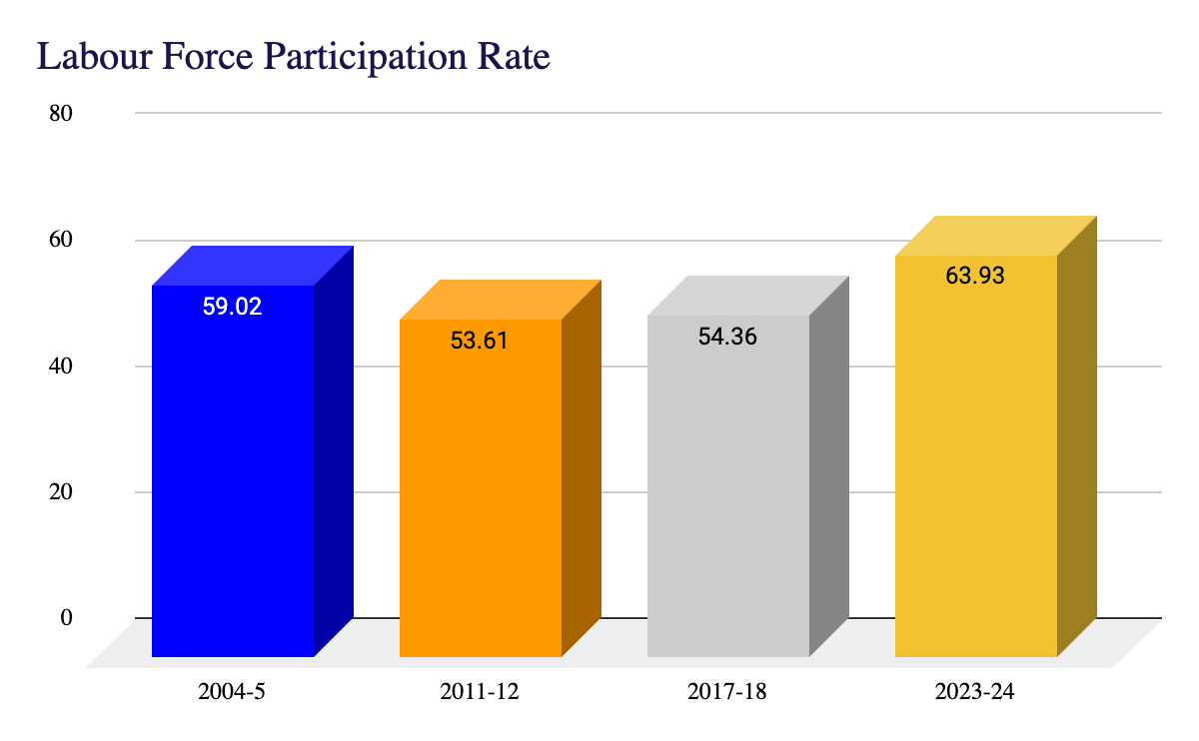
Labour Force Participation Rate (LFPR)
The labour force participation rate is the percentage of the working-age population (typically aged 15 and over) that is either employed or actively looking for work.
LFPR =((Employed People+Unemployed People)/(Total Population)) *100

Slide 5
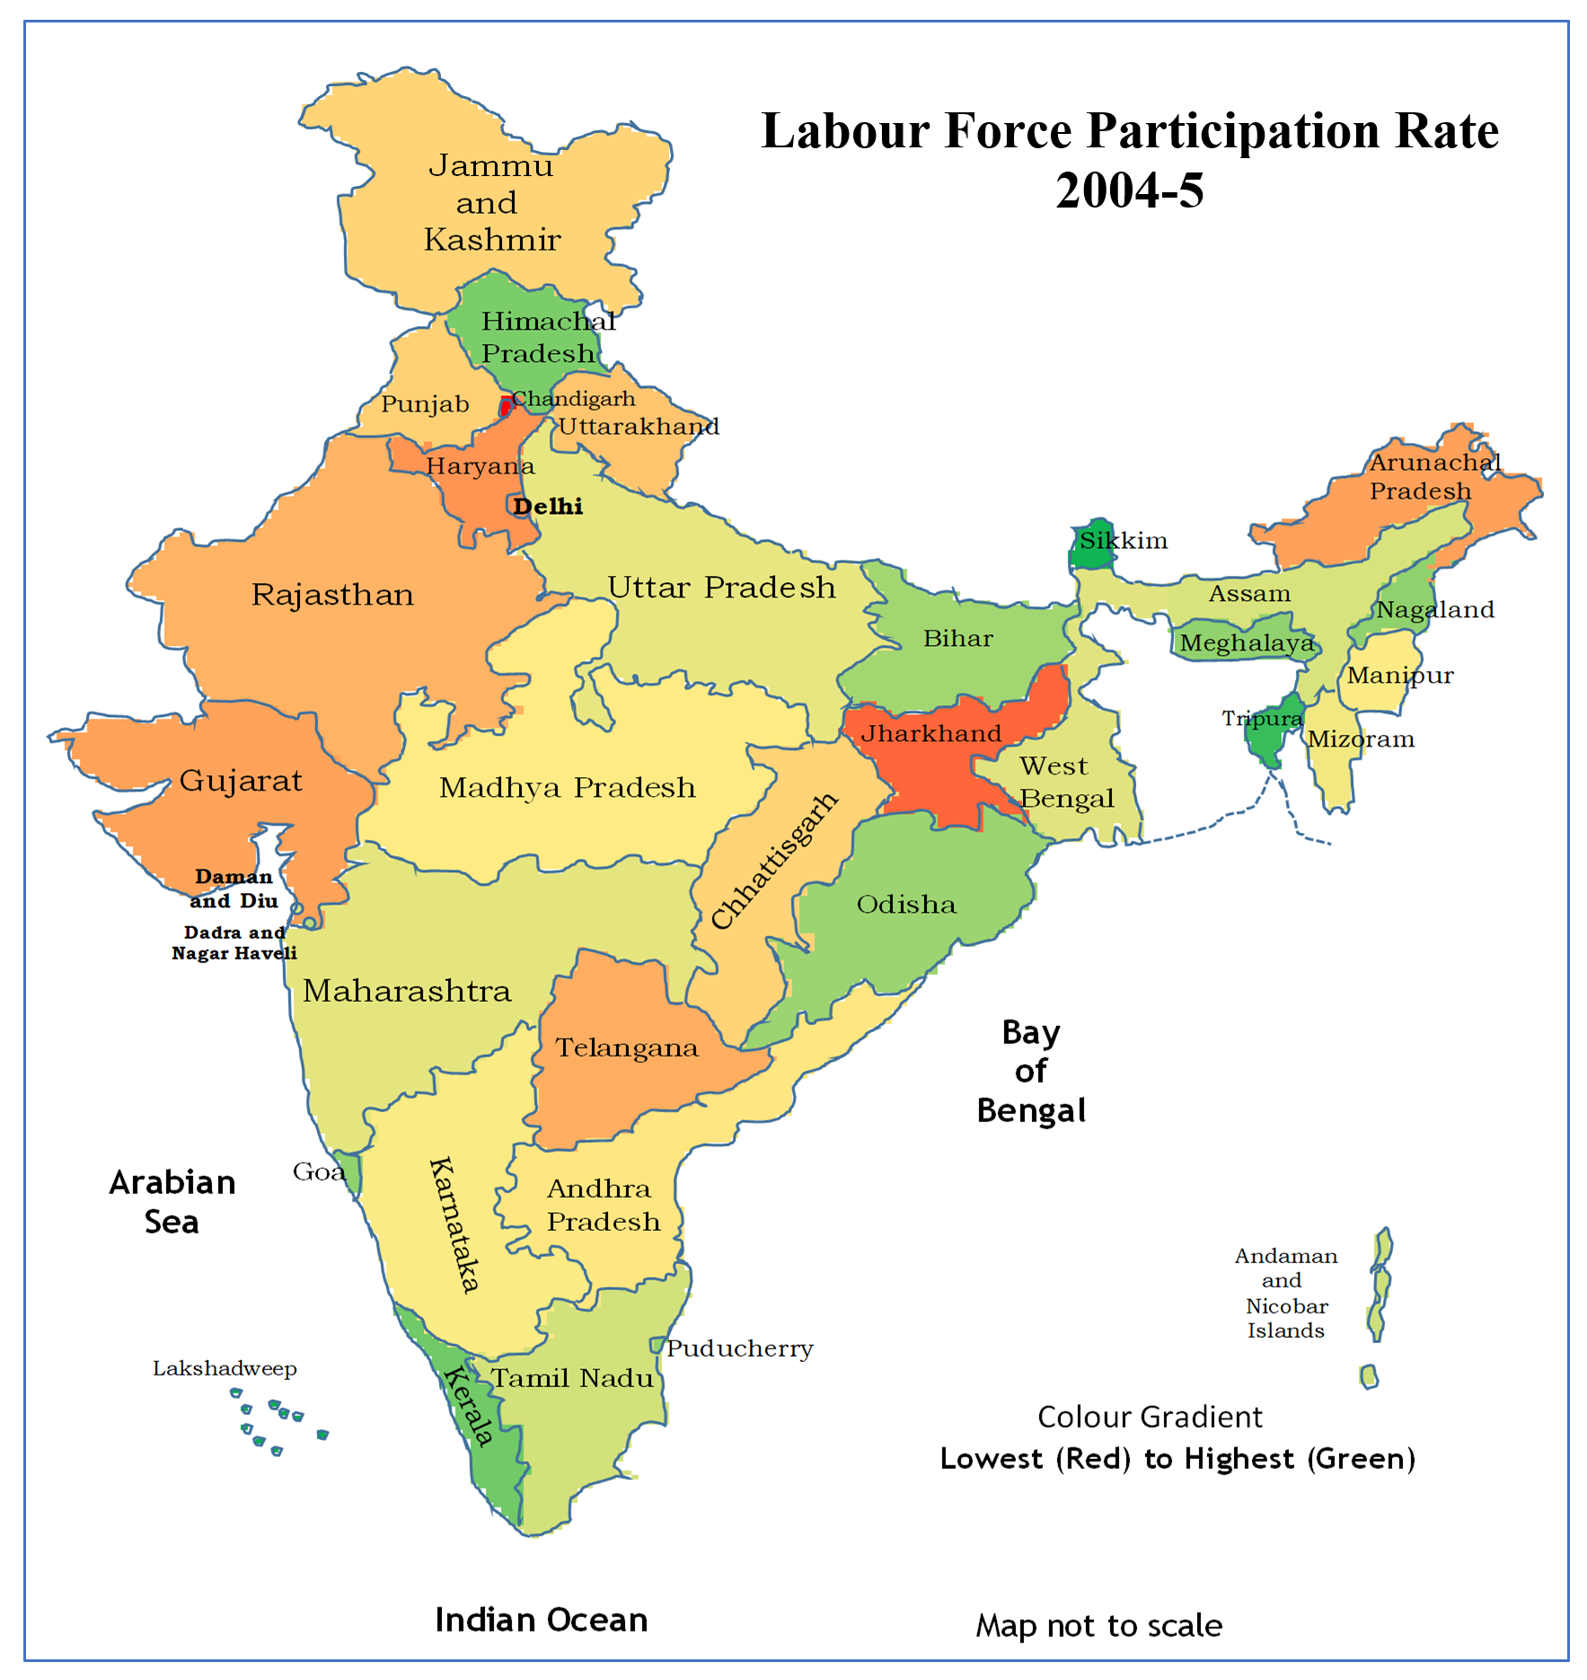
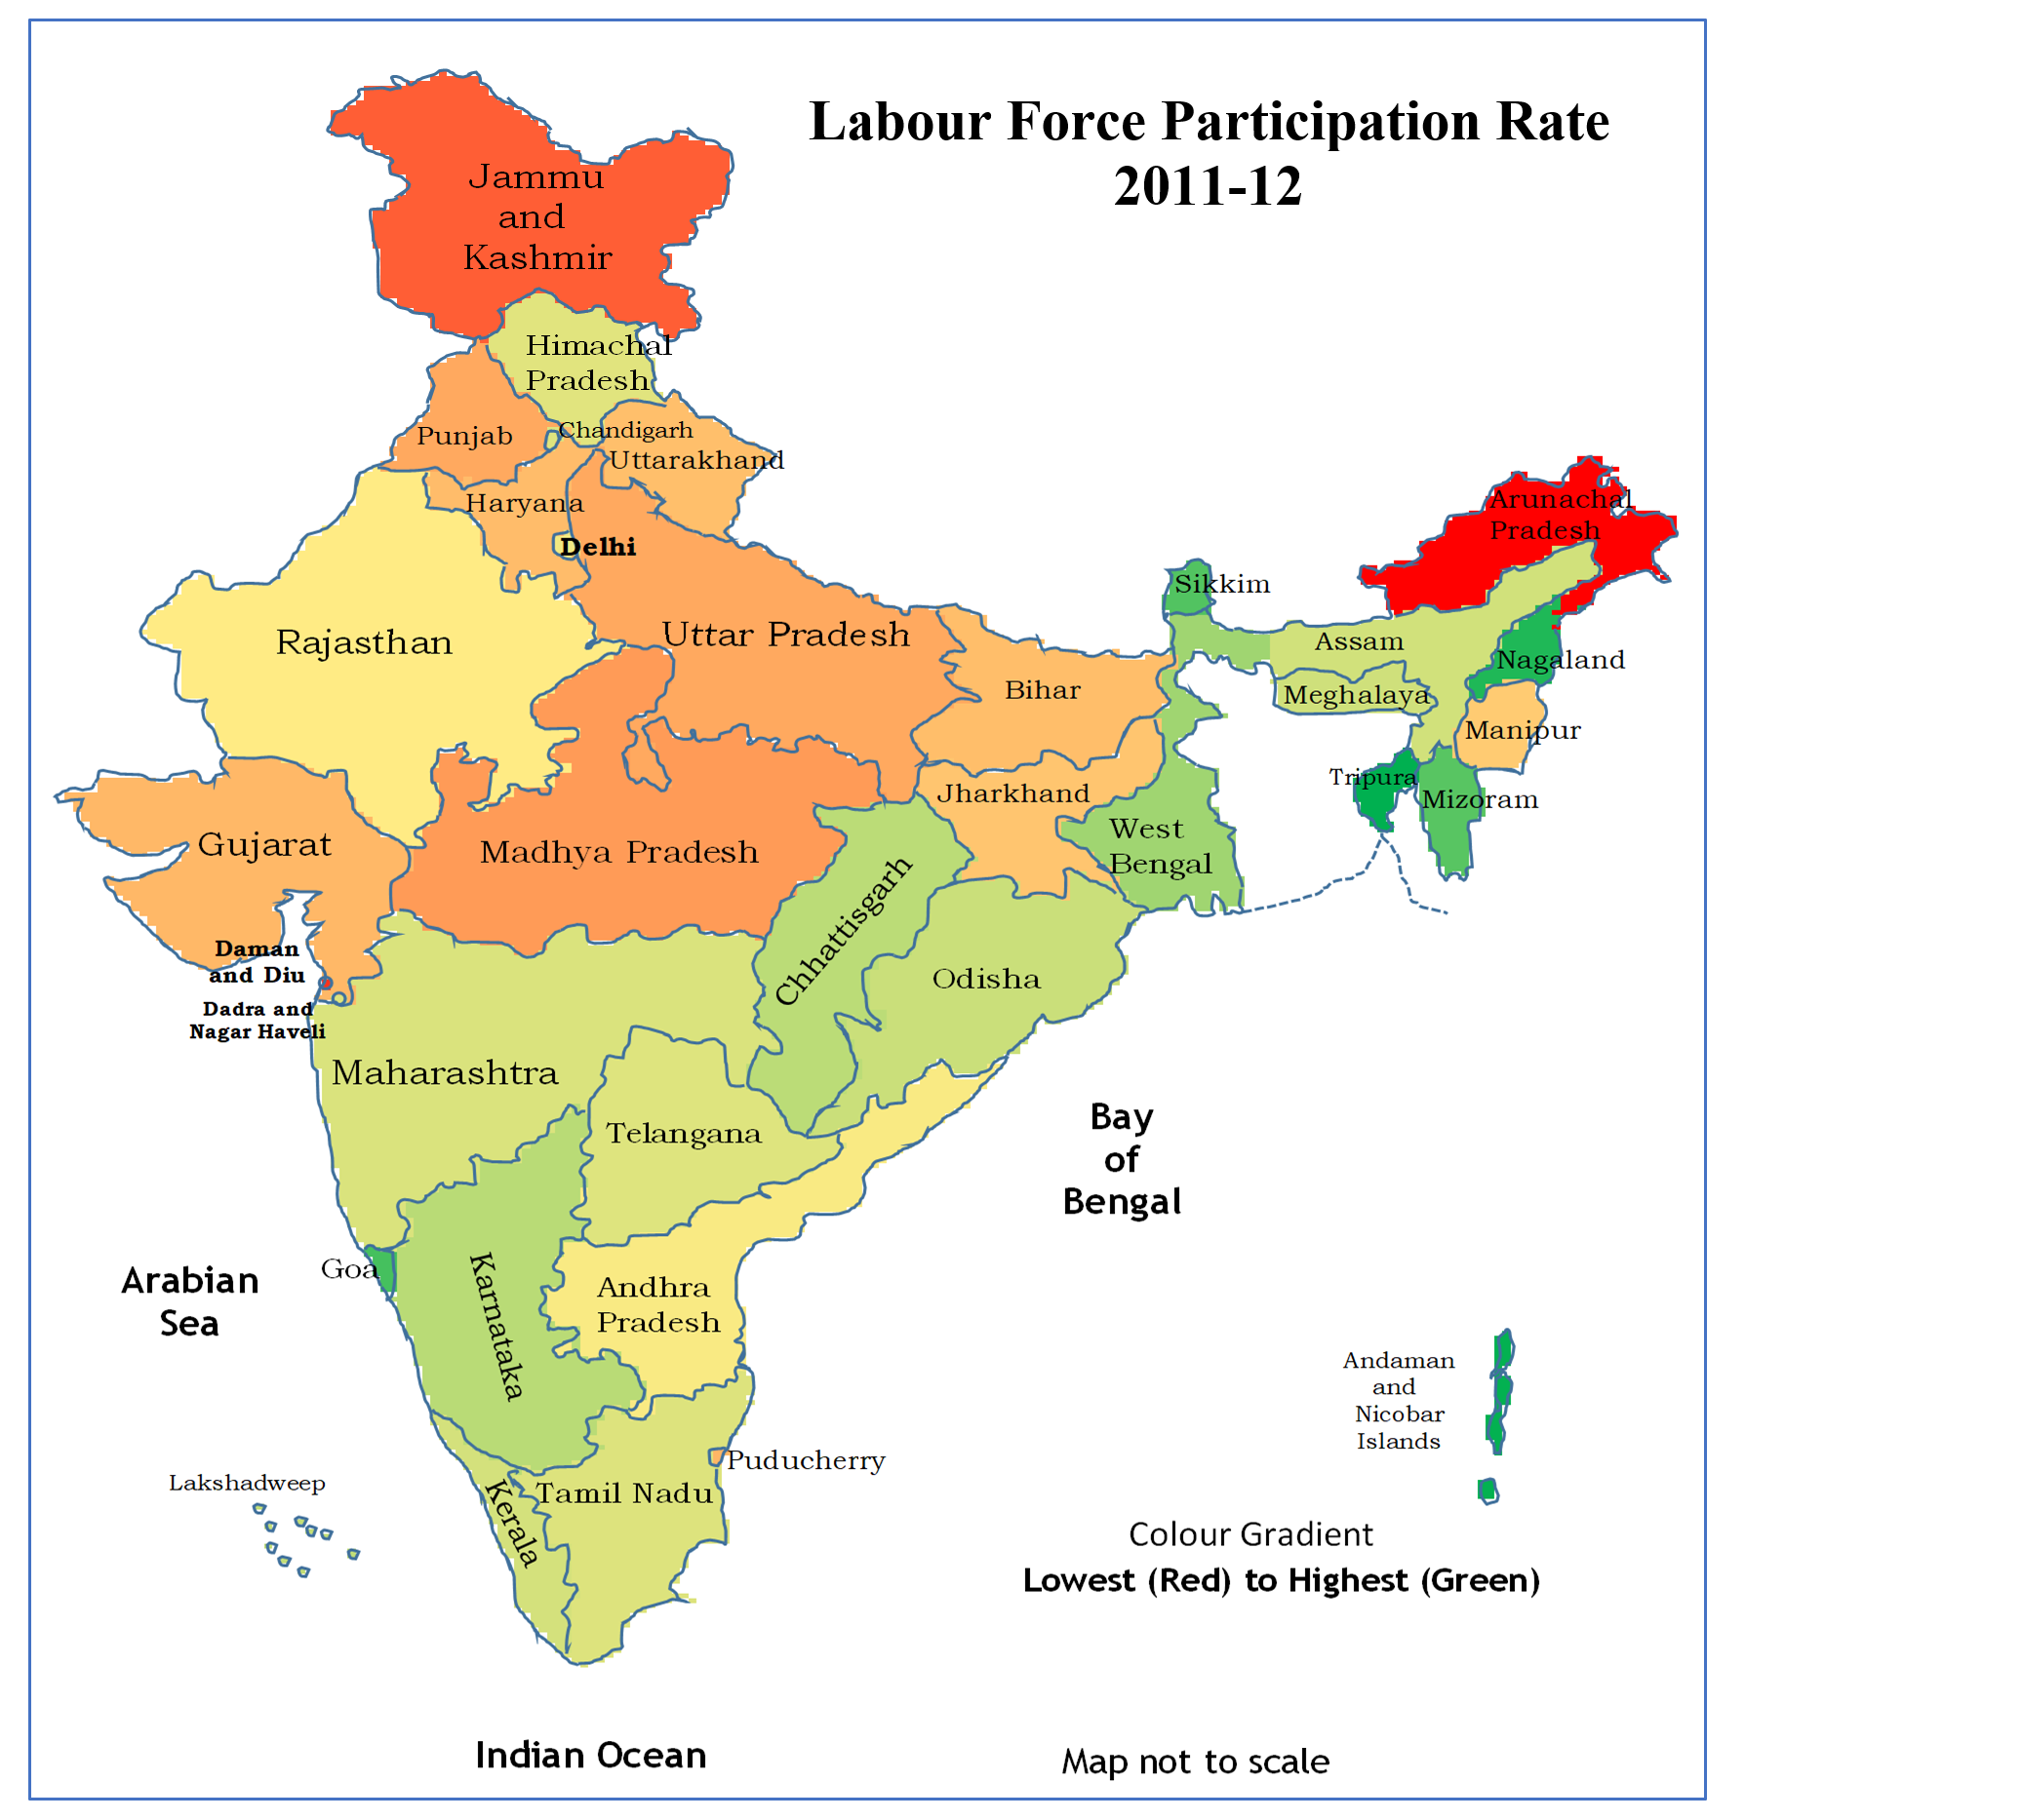
Review of Trends over the years!

Slide 6
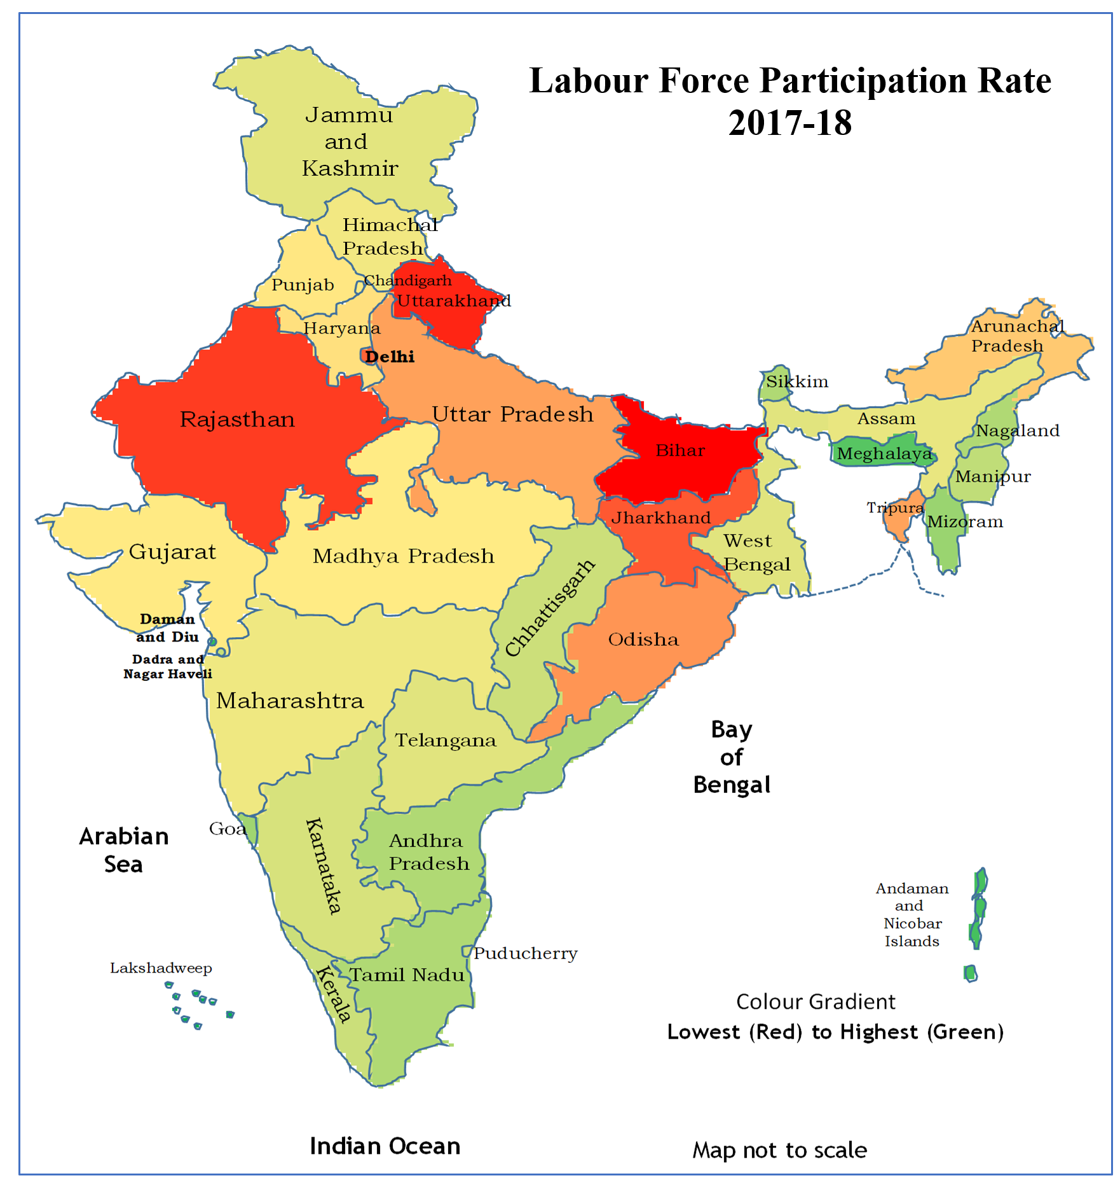
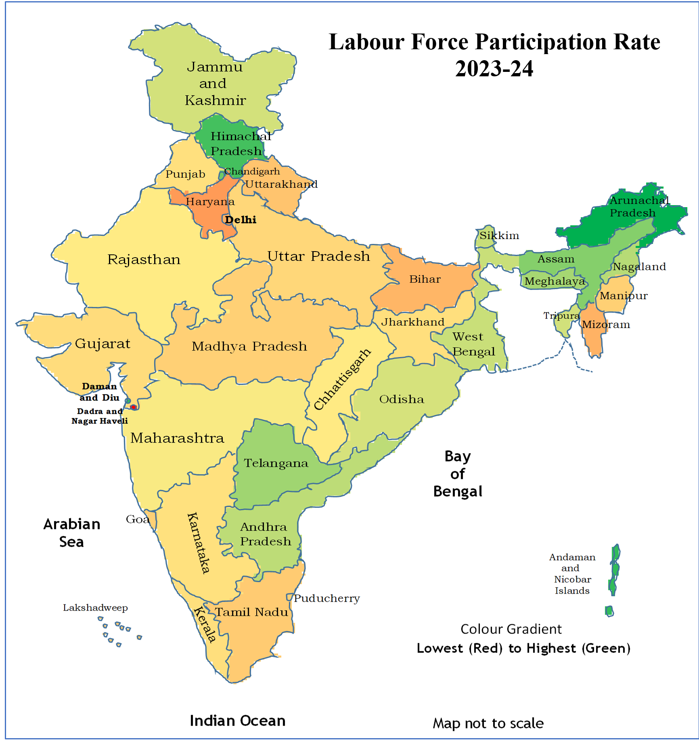
Review of Trends over the years!

Slide 7
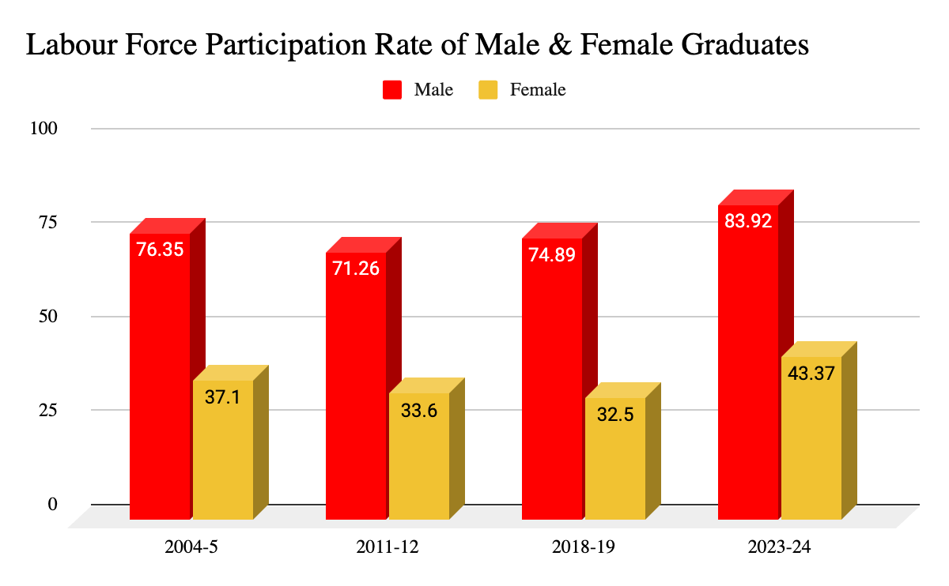
Examination through the Lens of Gender
Male graduates have maintained a dominant presence in the job market with a notable increase to 83.92% in 2023–24. This is due to the rapid expansion of the private sector & enhanced entrepreneurial opportunities.
Though female graduates initially experienced a downward trend but the period of 2023–24 marked a significant recovery, as female participation surged to the highest level observed in the last two decades.
This shift could be due to growth of flexible remote work options & government schemes supporting women in entrepreneurship.

Slide 8
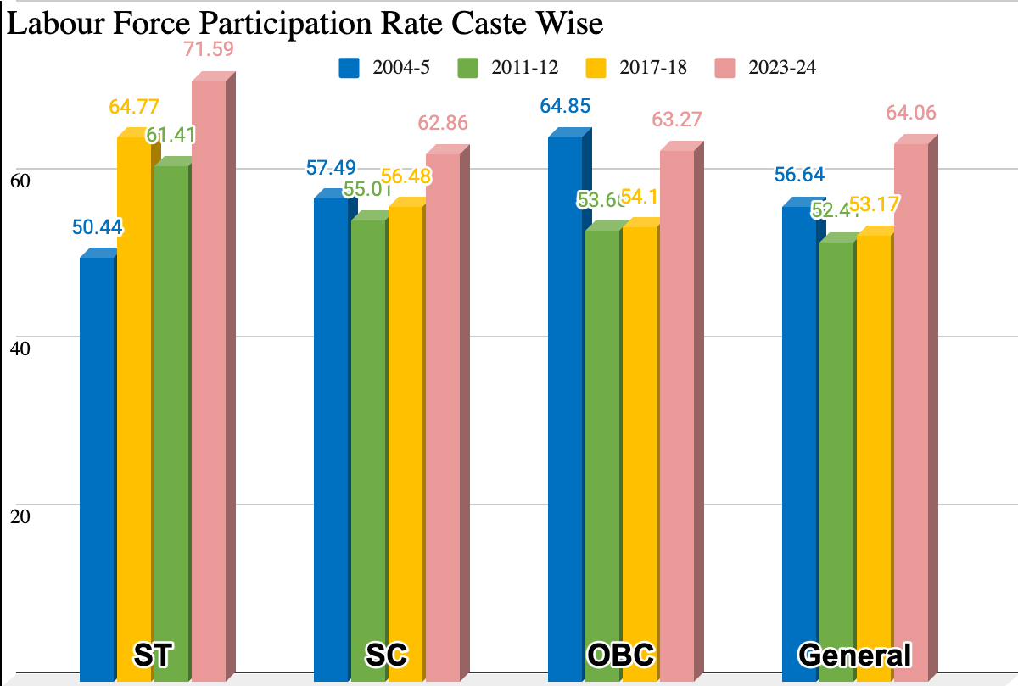
Examination through Lens of Caste
Among the four major social groups, the ST category has shown the most significant rise.
The SC category also showed a steady improvement, increasing from 57.49% in 2004-05 to 62.86% in 2023-24.
This U-shaped pattern of OBC may indicate that the initial decline was a result of structural changes, followed by improved employment integration in the subsequent decade.
The General category displayed a more stable trend with minor fluctuations.
Enhancing skill development and vocational training specifically designed for youth from SC, ST and OBC can greatly improve their employability.

Slide 9
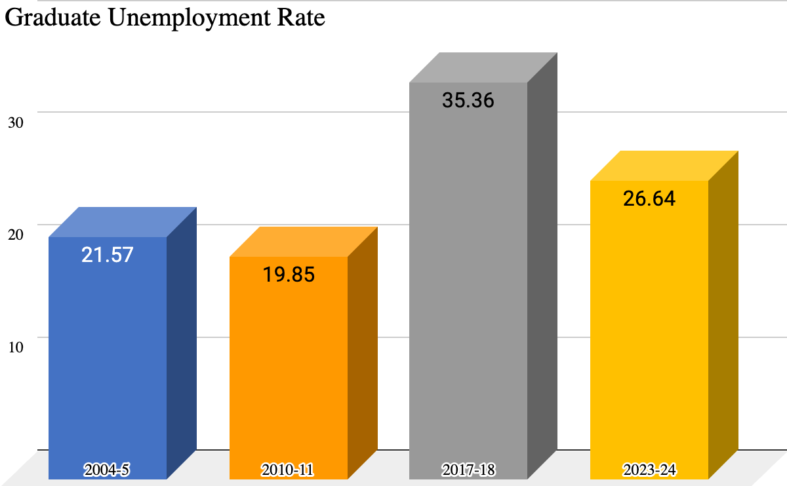
Unemployment Rate (UR)
The unemployment rate is the percentage of the labor force that is actively seeking work but is unable to find a job.It is a key indicator of the health of an economy.
Unemployment rate % = (unemployed people/labour force ) * 100.
The graduate unemployment rate has shown significant fluctuations over the years.
The sharp increase in 2017–18 might be because of economic slowdowns, mismatch between education and industry needs,
The recent decrease by 2023–24 likely reflects efforts to bridge the skills gap, promote entrepreneurship & align education more closely with market demands.

Slide 10
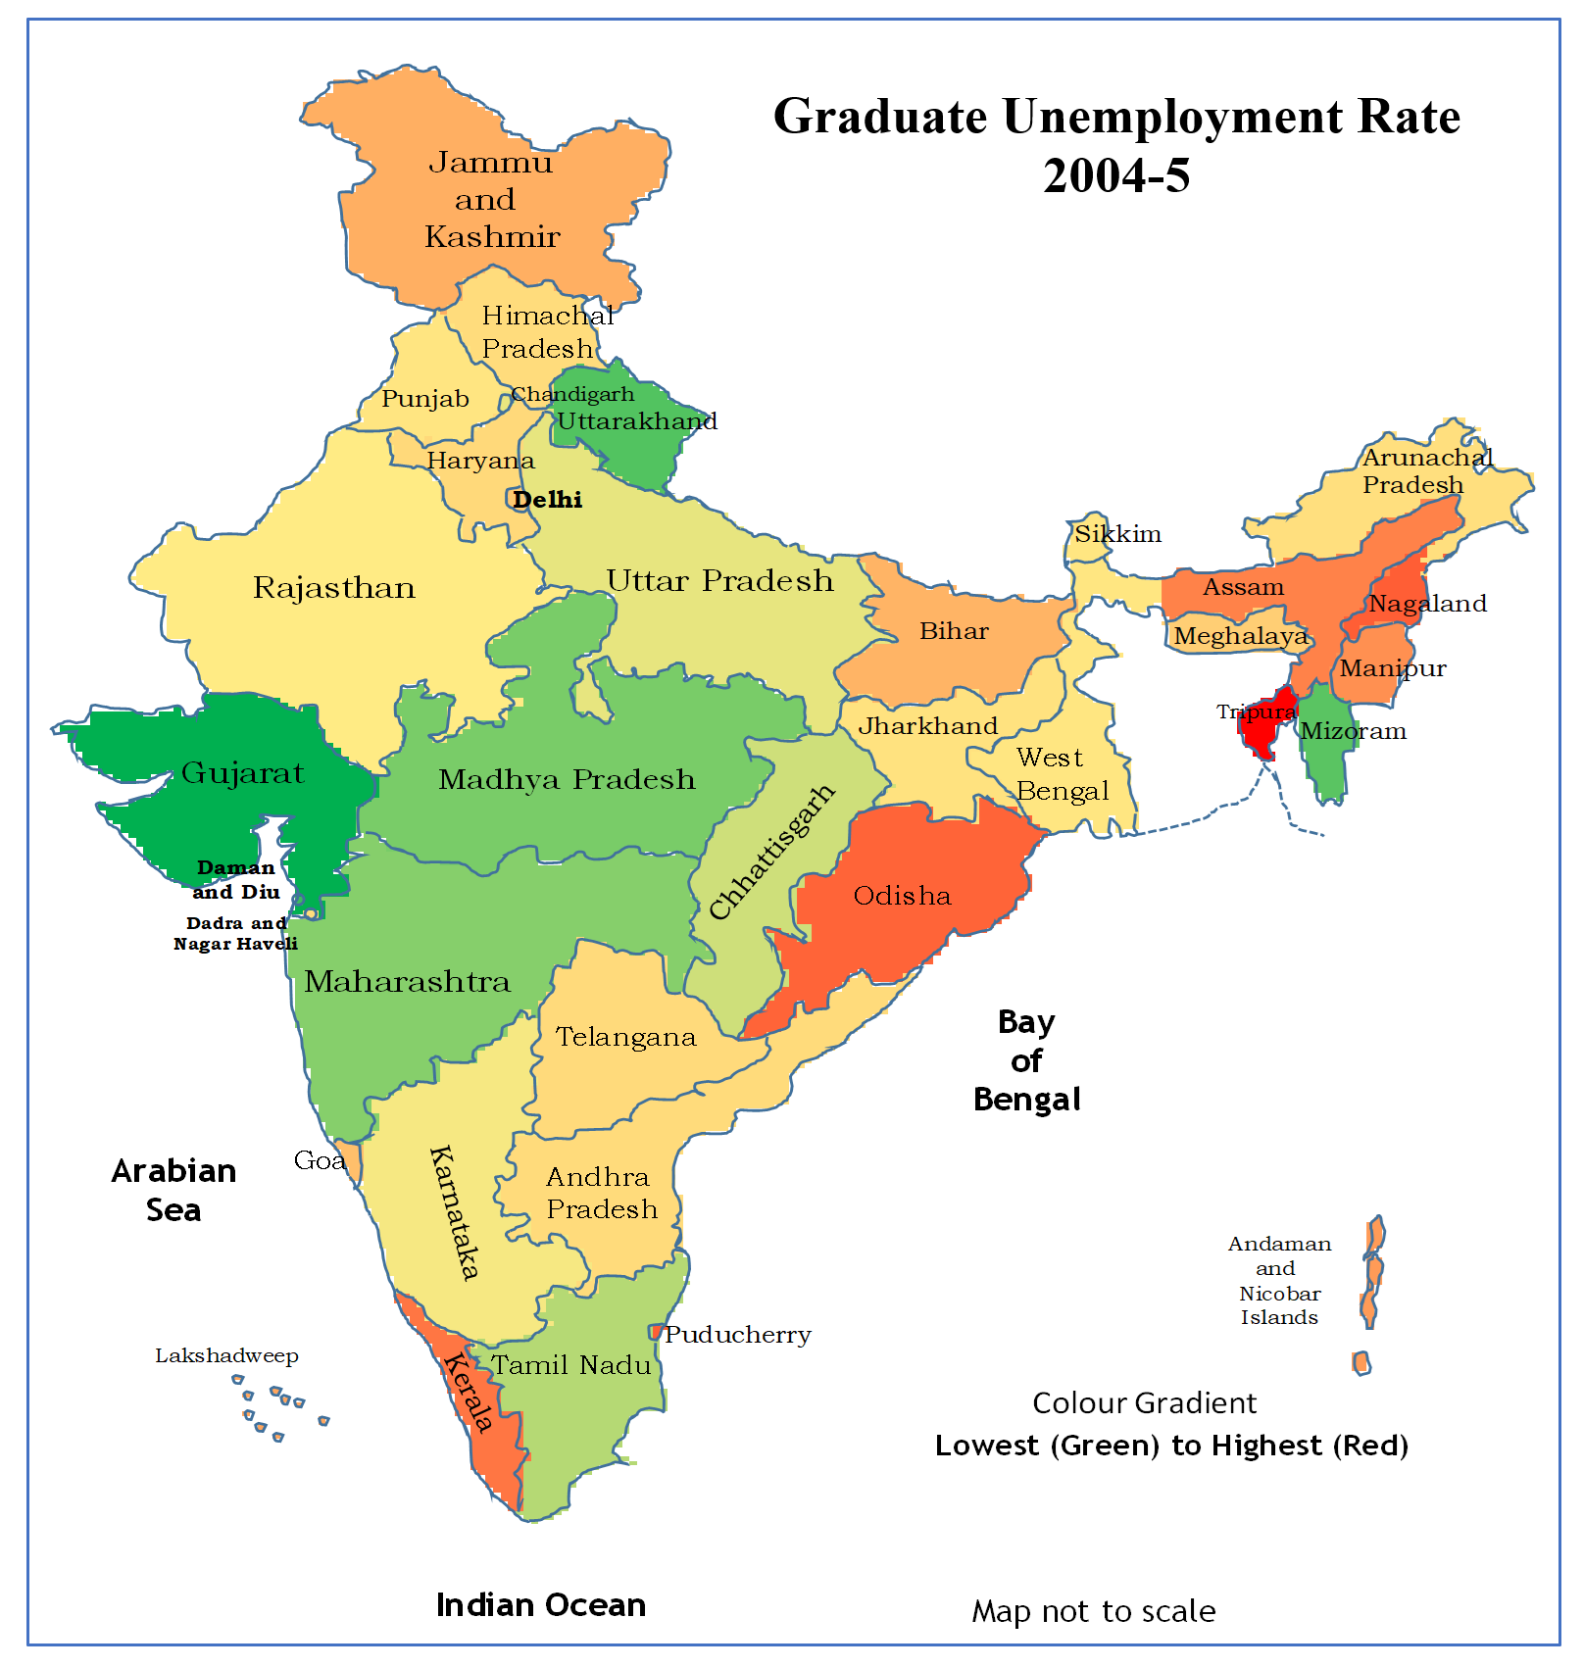
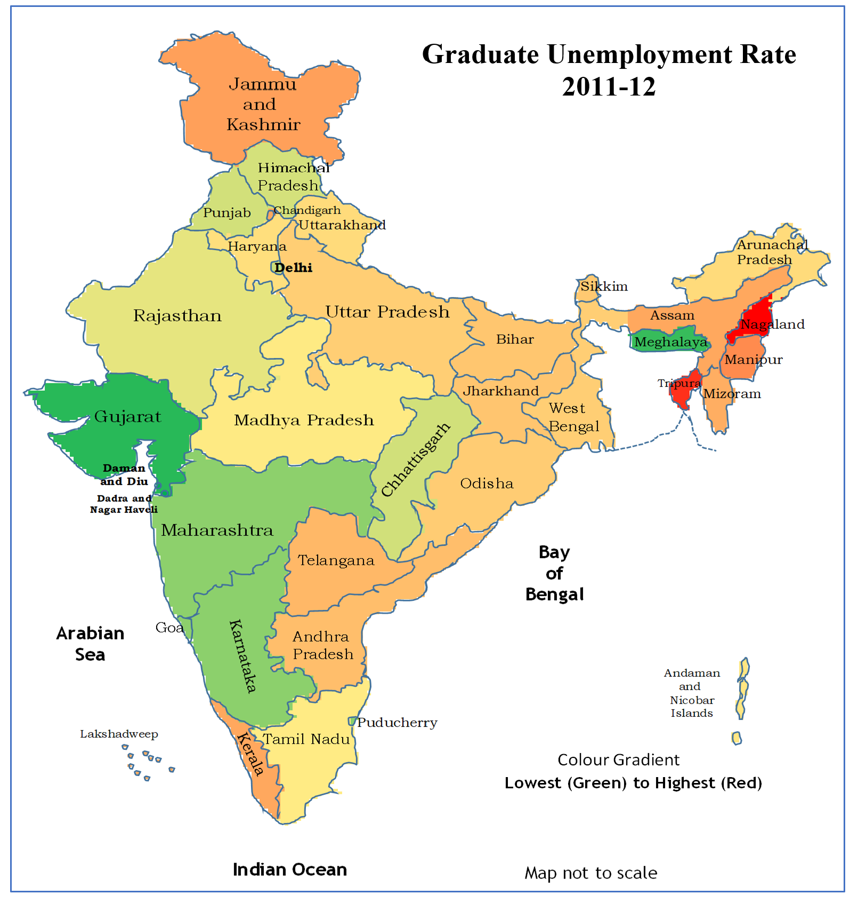
Detailed Exploration of trends over the Years

Slide 11
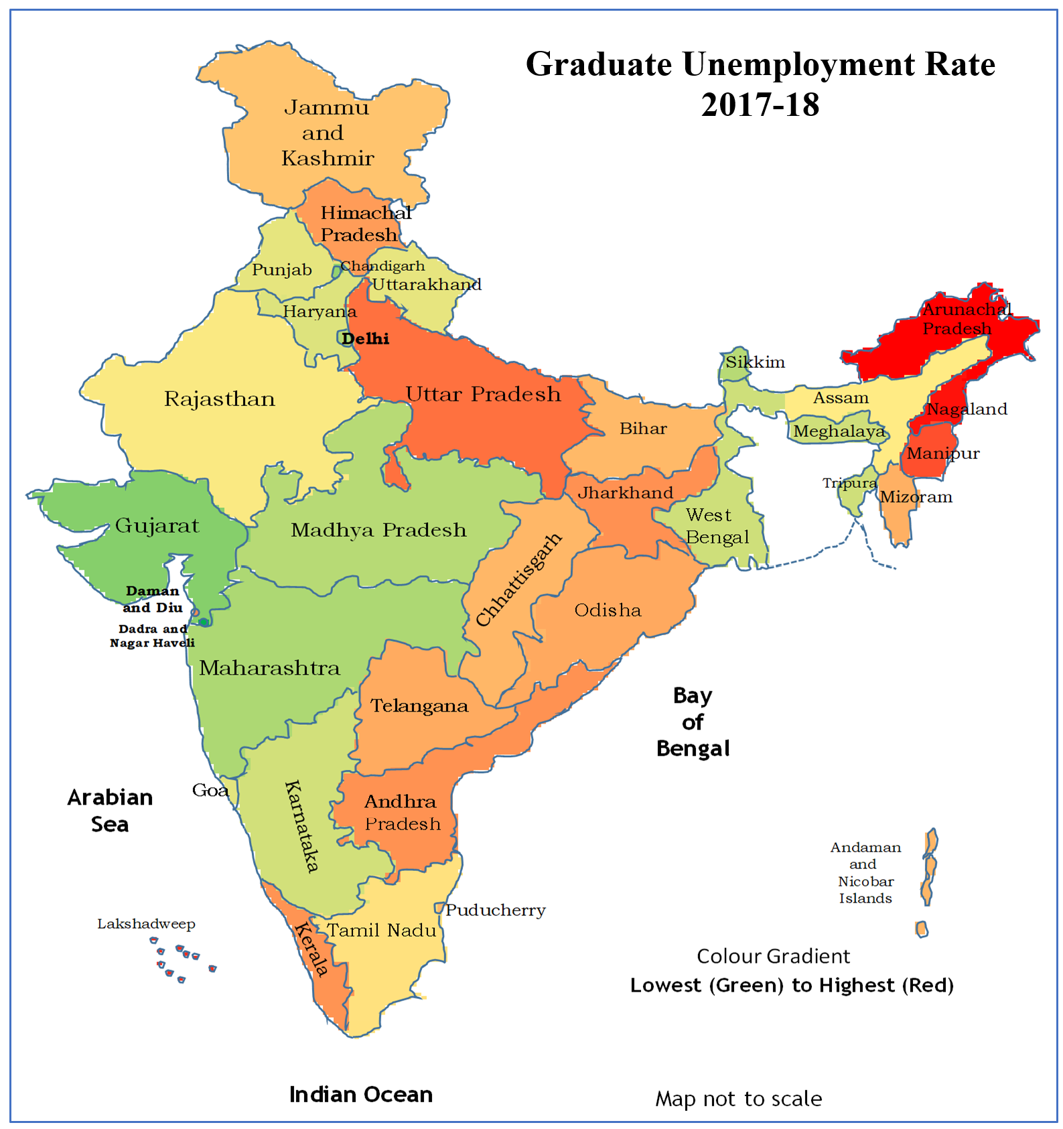
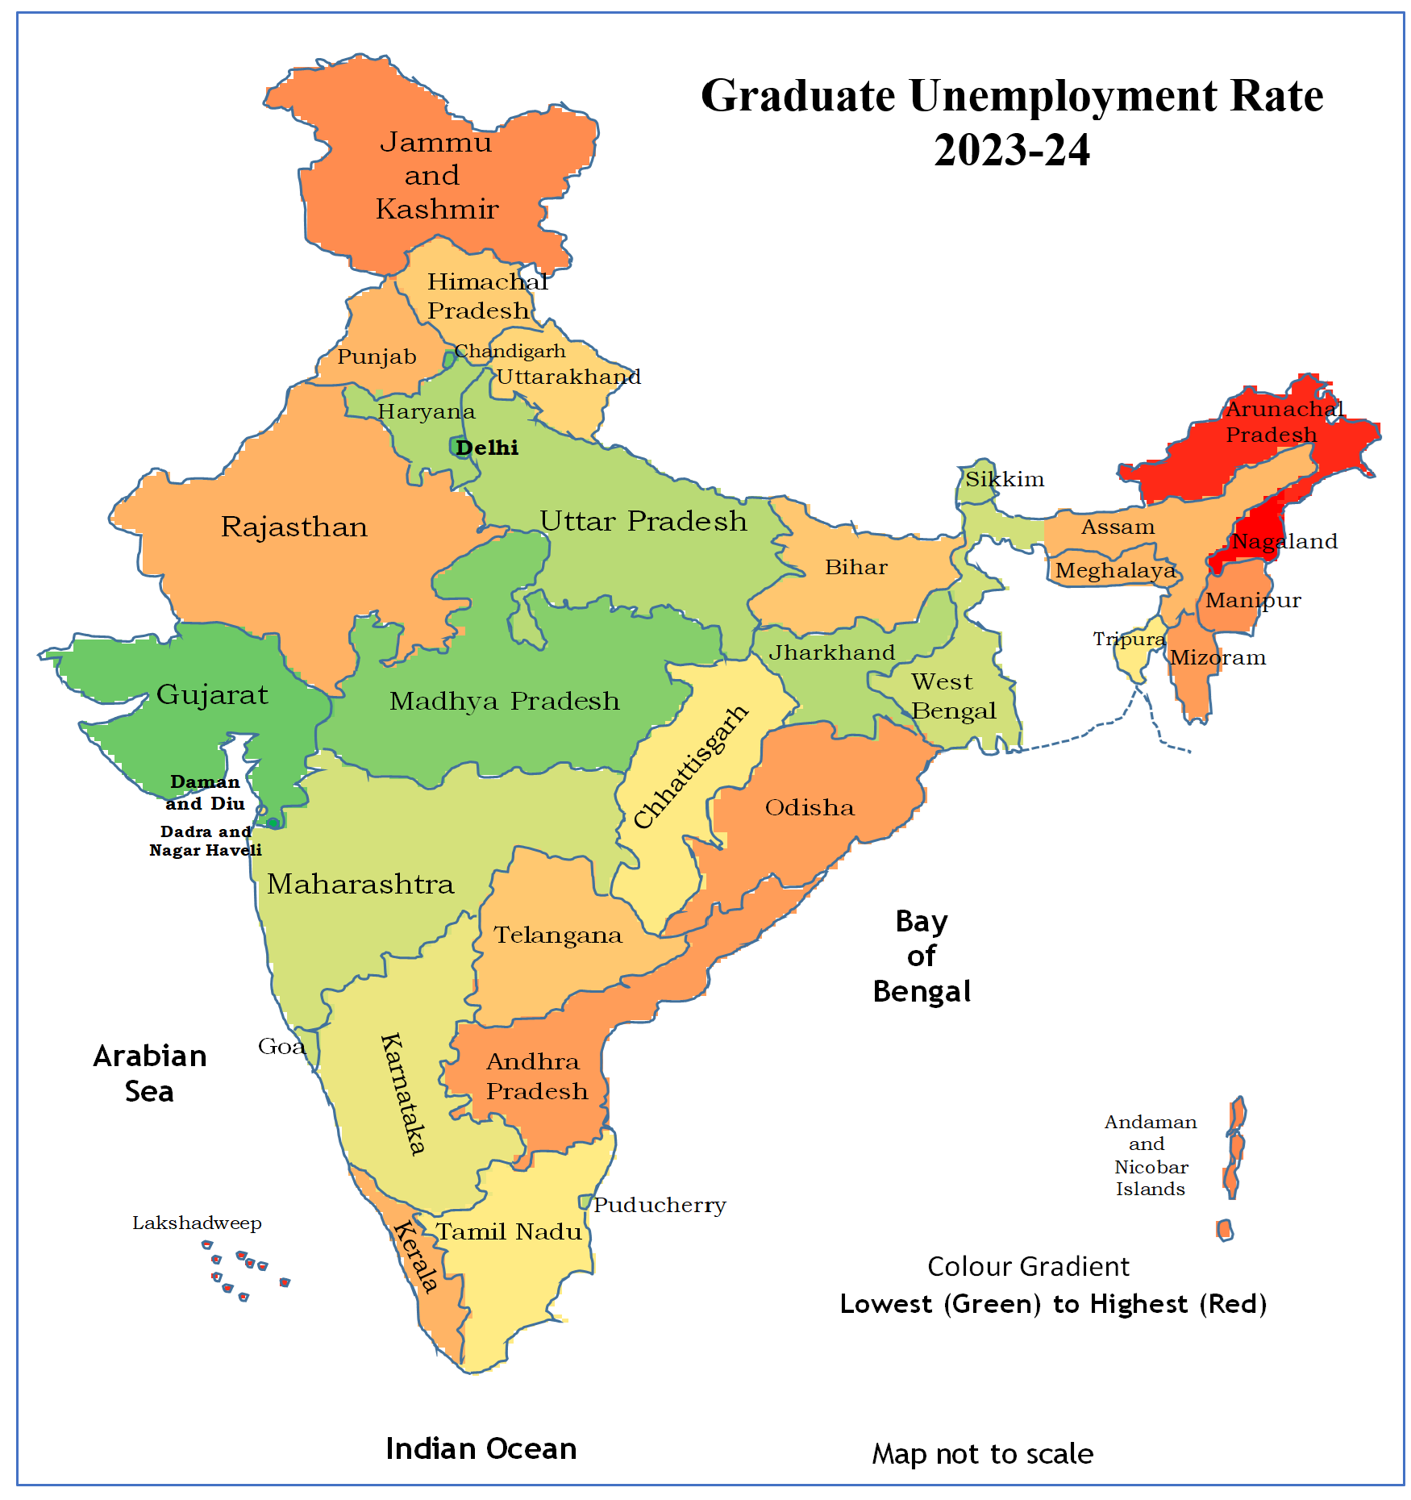
Detailed Exploration of trends over the Years

Slide 12
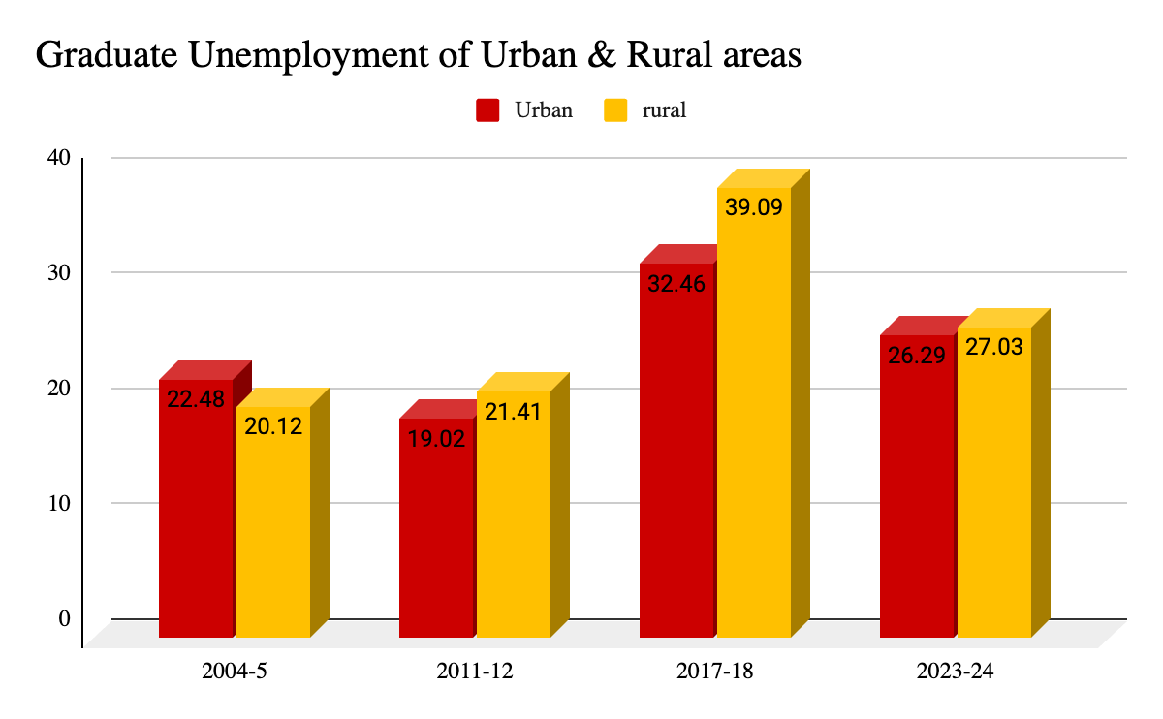
Examination through Lens of Region
Both urban and rural regions have seen some reduction in graduate unemployment since the 2017–18 peak, the rates in 2023–24 remain notably higher than those in the early 2000s.
This suggests that although there has been some recovery, the underlying issues affecting graduate employability persist , especially in rural areas.

Slide 13
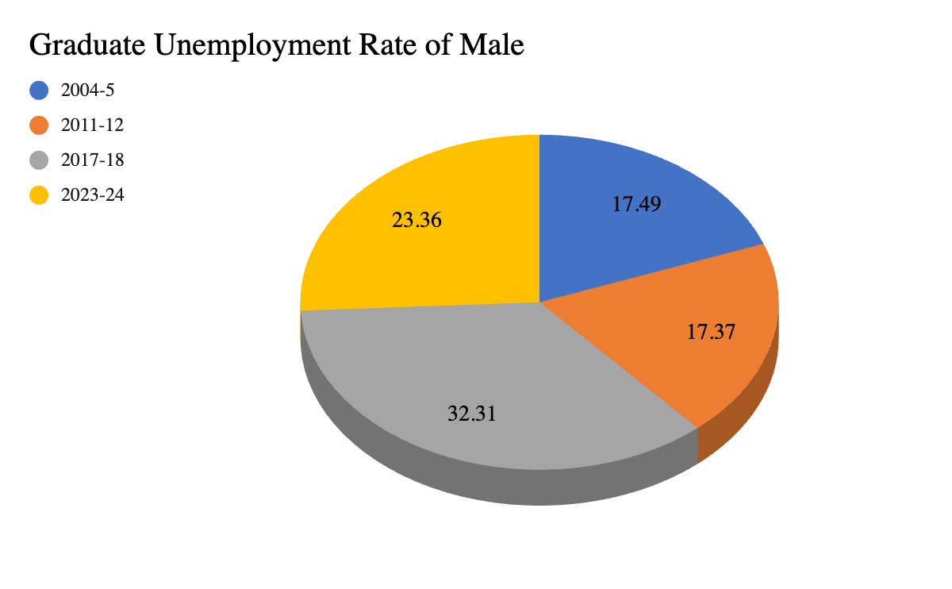
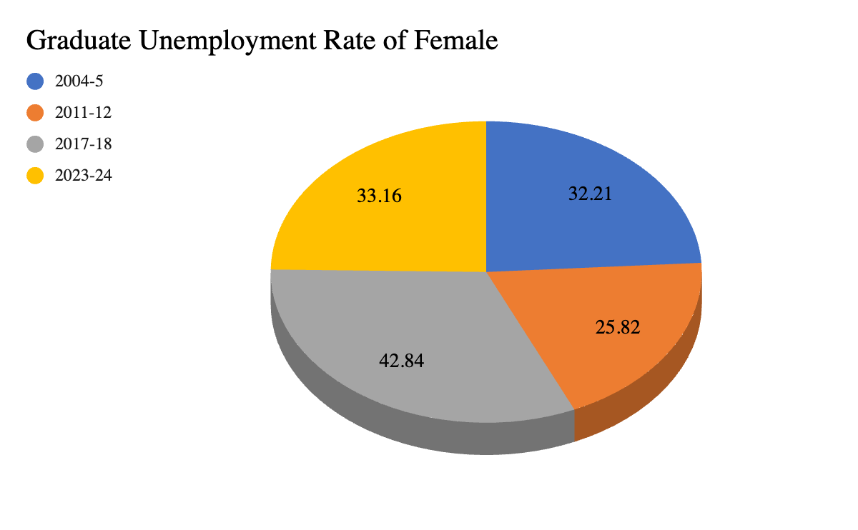
Examination through Lens of Gender
Female graduates consistently faced higher unemployment rates than their male counterparts in all observed years. This highlights the ongoing gender inequality in employment opportunities for graduates, emphasizing the urgent need for targeted policies to support women's transition from education to the workforce.

Slide 14
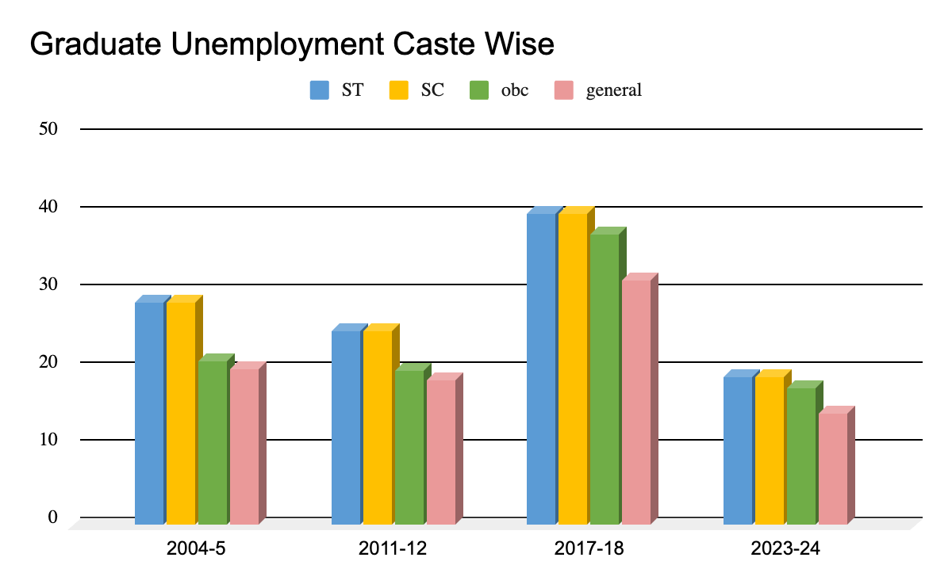
Examination through Lens of Caste
While the overall unemployment rates have declined significantly in recent years, historically marginalized communities such as STs and SCs continue to face higher rates compared to the general category. The sharp rise in 2017–18 serves as a reminder of the vulnerability of these groups during times of economic stress.
The data underscores the need for targeted interventions, inclusive policy-making, and equitable opportunities in education and employment to bridge the gap and ensure fair access to livelihoods for all social groups.

Slide 15
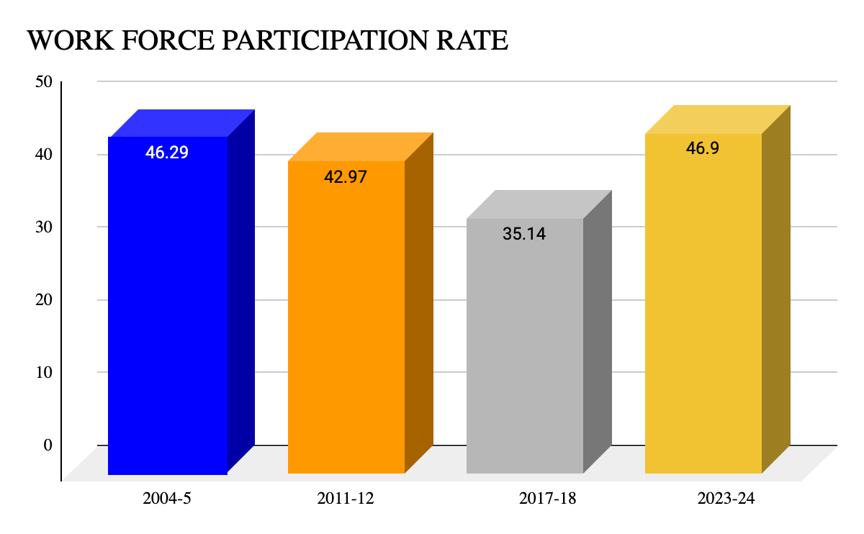
Workforce Participation Rate (WFPR)
It refers to the percentage of the working-age population that is employed.
WFPR = ((Total Employed )/Total Population) *100
The detailed analysis on basis of gender, caste has been done in report.

Slide 16
Sector-wise Employment Statistics for Graduates
The swift growth of digital payment systems, online banking, and investment platforms has generated new employment opportunities in the finance sectors. Government programs such as Jan Dhan Yojana and UPI have stimulated job creation in rural and urban areas.
Schemes like PMAY (Pradhan Mantri Awas Yojana) boosted construction-related employment.
Growth in Agri-Tech Startups & Government Push for Sustainable Farming remarkably recovered sector of Agriculture in year 2023-24.
The Public Administration Sector experienced a notable decrease.Major reasons are Enhanced Opportunities in the Private Sector that provides superior salaries, adaptable work culture.

Slide 17
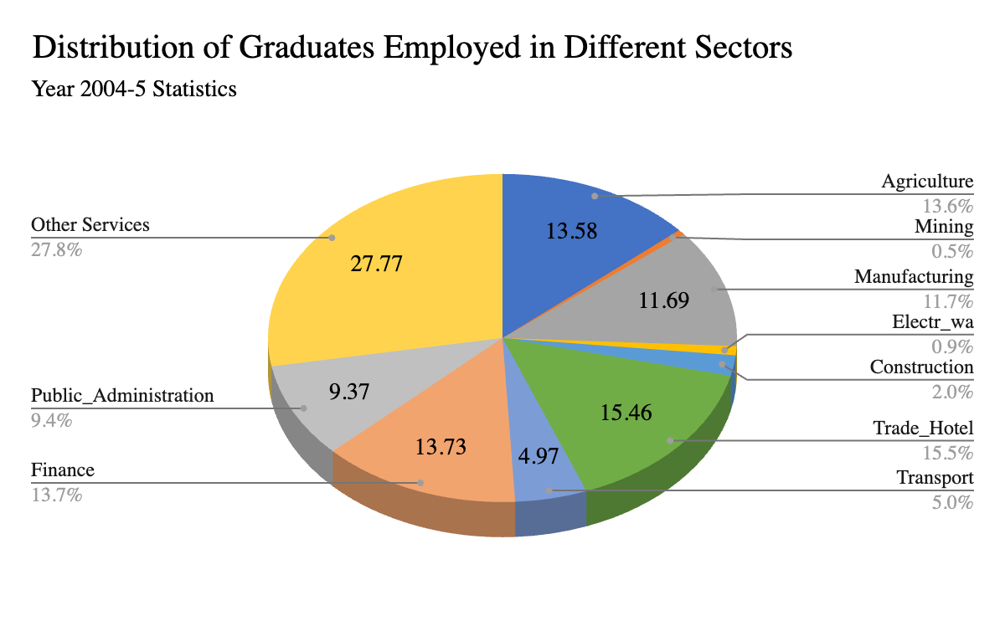
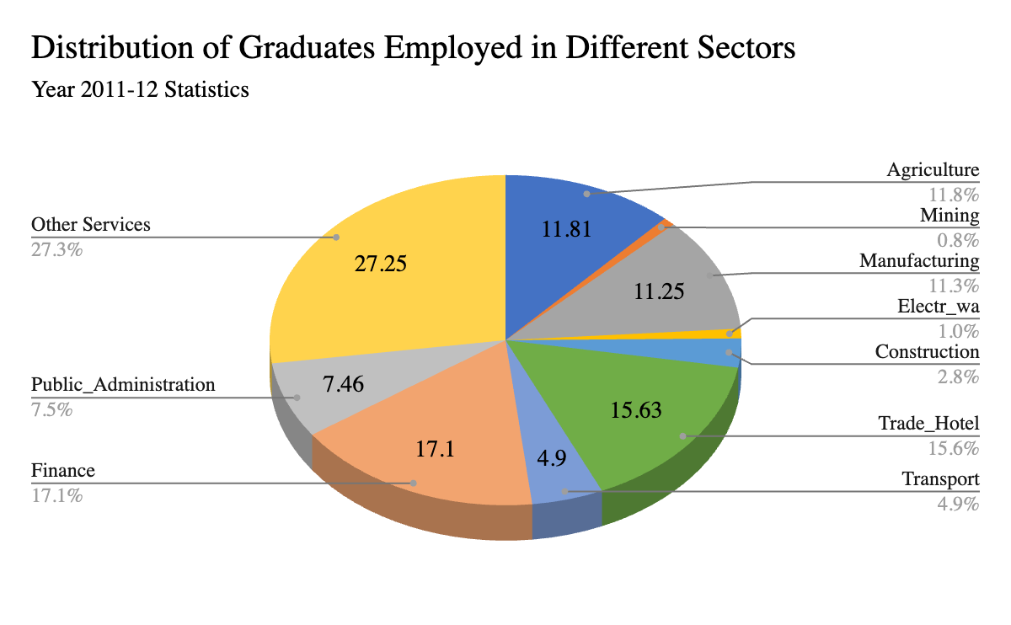
Distribution of Graduates Employed in Different Sectors

Slide 18
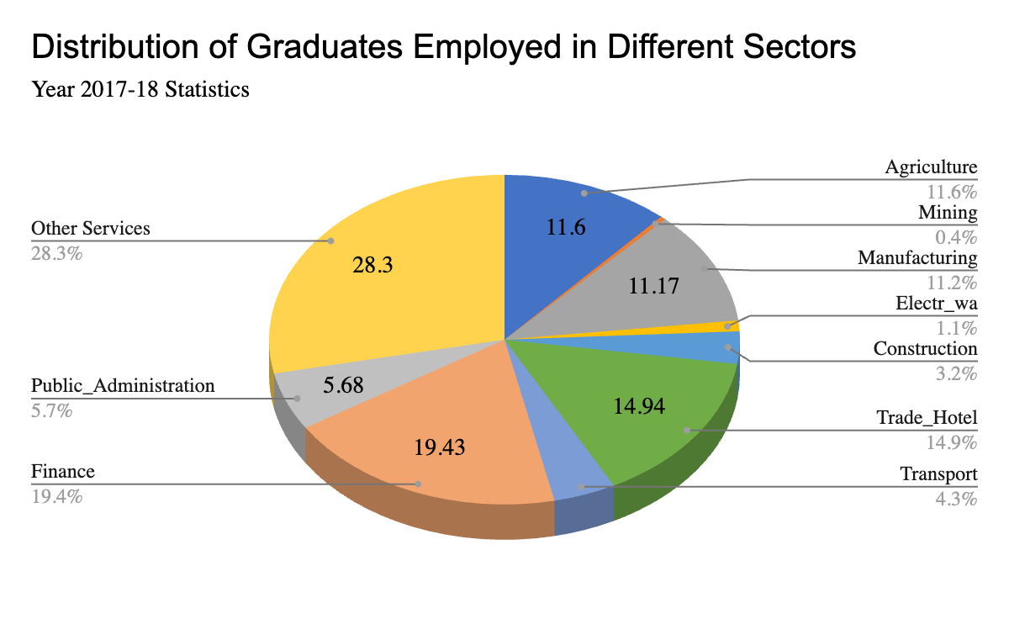
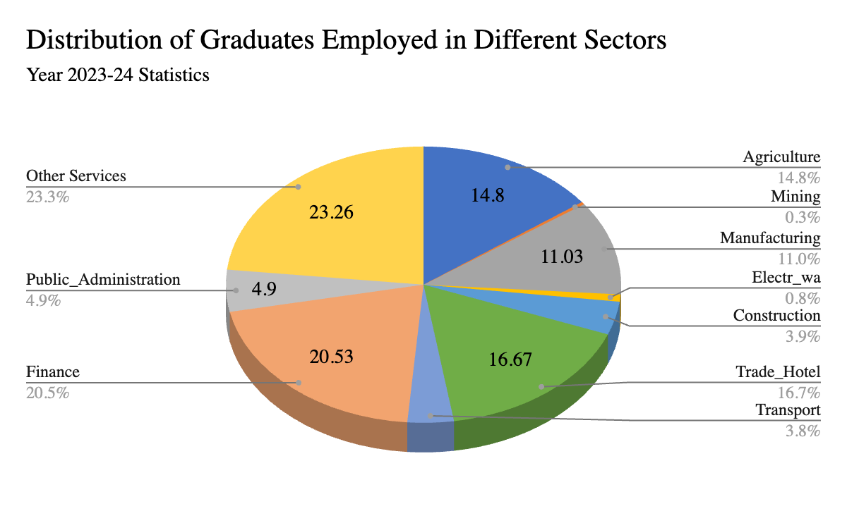
Distribution of Graduates Employed in Different Sectors

Slide 19
CONCLUSION
The examination of India's graduate unemployment data demonstrates how complicated and constant this issue is.
The differences in regional economies, the availability of quality jobs, the growth of manufacturing and service industries, the migration of graduates from other parts of the country and the religion and caste differences all play a significant role in shaping regional disparities.
For India to harness its demographic dividend to its maximum potential, a tailored, region-specific approach is essential.
This strategy should focus on encouraging entrepreneurship, enhancing skill development opportunities, and supporting the growth of high-potential industries in each state and union territory.

Slide 20
THANK YOU!

